Slide 1
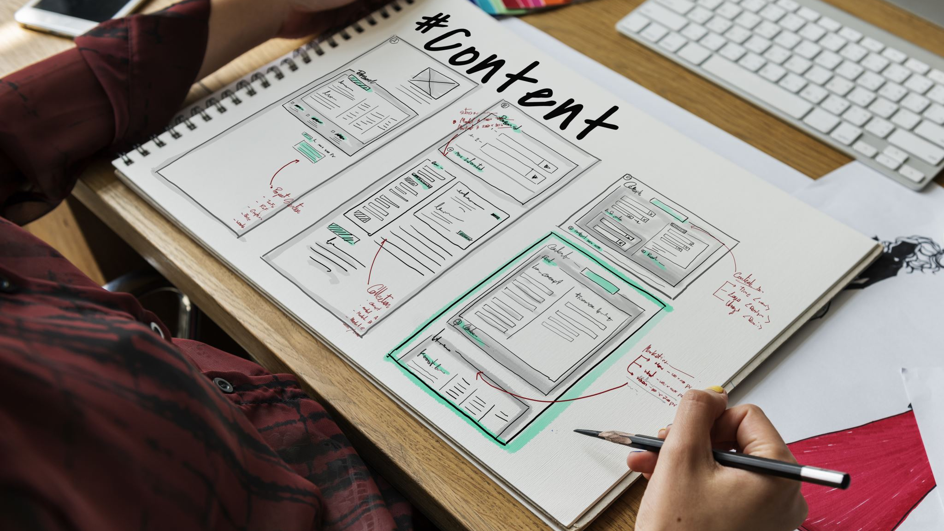
Chapter 23 – Project planning
Group 27
Software Engineering class SE104.N23
Lecturer: Nguyen Thi Thanh Truc
Plans are useless, but planning is indispensable General Dwight D. Eisenhower

Slide 2
Team Member
Trương Văn Khải – 21520274
Ngô Phúc Danh – 21521924
Lê Ngô Minh Đức – 21520195
Lê Yến Nhi - 21522427

Slide 3
Topics covered
01. Project planning
02. Software pricing
03. Plan-driven development
04. Project plan in PDD
05. Project scheduling
06. Agile planning
07. Estimation techniques
08. Algorithmic cost modeling
09. COCOMO cost modeling

Slide 4
01. Project planning
Project planning involves breaking down the work into parts and assign these to project team members, anticipate problems that might arise, and prepare tentative solutions to those problems
The project plan: which is created at the start of a project, is used to communicate how the work will be done to the project team and customers, and to help assess progress on the project

Slide 5
01.1 Planning stages
Planning is done:
At the proposal stage, when you are starting for a contract to develop or provide a software system
During the project startup phase, when you have to plan who will work on the project, how the project will be broken down into increments, how resources will be allocated across your company, etc.
Periodically throughout the project, when you modify your plan in the light of experience gained and information from monitoring the progress of the work

Slide 6
01.2 Proposal planning
Planning may be planned with only outline software requirements
The aim of planning at this stage is to provide information that will be used in setting a price for the system to customers

Slide 7
02. Software pricing
Estimates are made to discover the cost, to the developer, of producing a software system
You take into account: hardware, software, travel, training, and effort costs
There is not a simple relationship between the development cost and the price charged to the customer
Broader organizational, economic, political and business considerations influence the price charged

Slide 8
03. Plan-driven development (PDD)
Plan-driven or plan-based development is an approach to software engineering where the development process is planned in detail.
Plan-driven development is based on engineering project management techniques and is the ‘traditional’ way of managing large software development projects.
A project plan is created that records the work to be done, who will do it, the development schedule, and the work products.
Managers use the plan to support project decision making and as a way of measuring progress.

Slide 9
03.1. Plan-driven development – pros and cons
Advantages of PDD | Disadvantages of PDD
Require knowledgeable personnel at the beginning. | Longer distance in each repetition or increase
Suitable for large systems and teams | Cannot accommodate changes any time
Appropriate for stable development environment. | Costly for the dynamic development environment.
Achievement attained through construction and directive. | Assume that, future changes will not occur.

Slide 10
04. Project plans in PDD
In a plan-driven development project, a project plan outlines resources, tasks, and schedule for development.
Plan sections
Introduction: objectives and constraints
Project organization: team, people, roles
Risk analysis: risks, probabilities, strategies to address risks
Hardware and software: resource requirements
Work breakdown: activities, milestones, deliverables
Project schedule: dependencies among activities, people and time allocated
Monitoring and reporting: mechanisms and reports

Slide 11
04.1. Project plan supplements
Plan | Description
Quality plan | Describes the quality procedures and standards that will be used in a project.
Validation plan | Describes the approach, resources, and schedule used for system validation.
Configuration management plan | Describes the configuration management procedures and structures to be used.
Maintenance plan | Predicts the maintenance requirements, costs, and effort.
Staff development plan | Describes how the skills and experience of the project team members will be developed.

Slide 12
04.2 The planning process
First project plan takes place although project preparation is an iterative procedure which takes place throughout the development startup stage.
As more information is gathered a proper plan takes place which includes plan to reflect supplies, schedule, and risk fluctuations.
Changing business aims also tips to changes in development plans. As business goals alteration, this could move all projects, which might then must be re-planned.

Slide 13
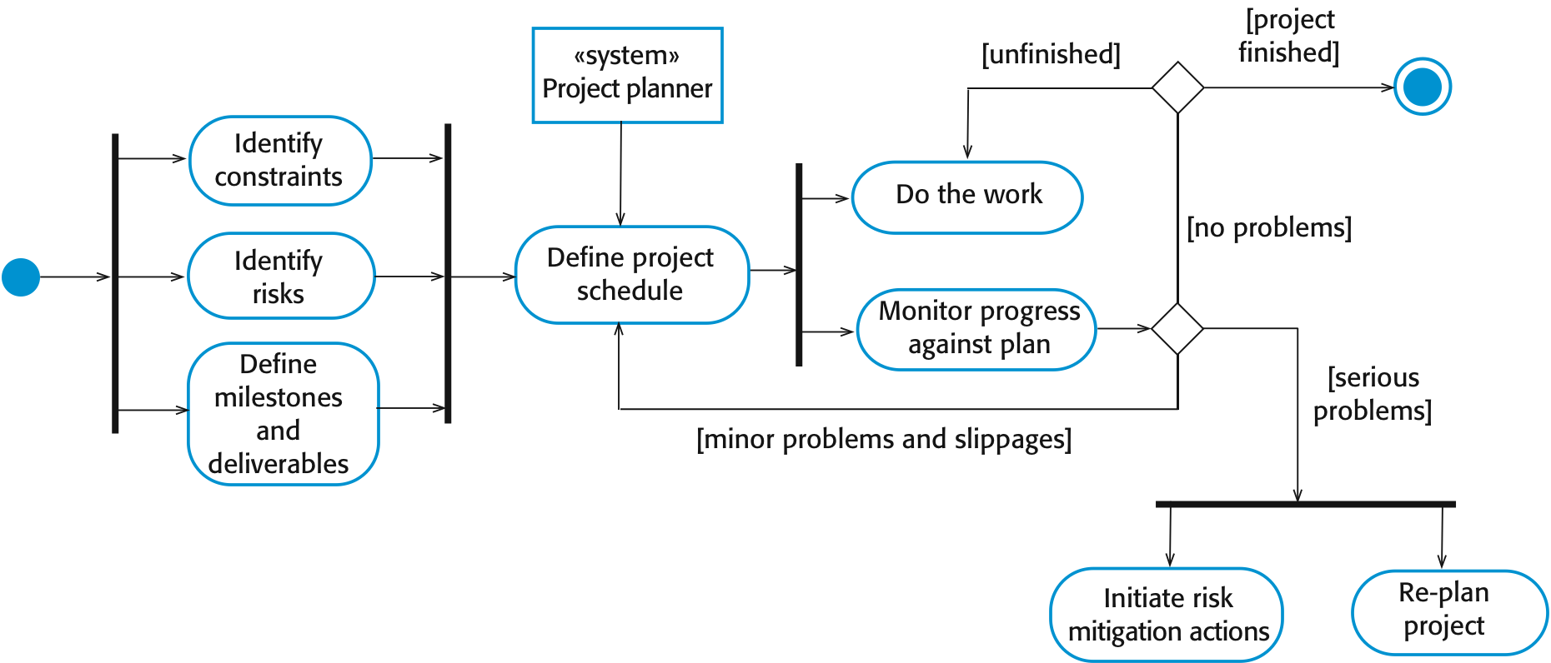
04.3 The project planning process

Slide 14
05. Project scheduling
Project scheduling is the process of deciding how the work in a project will be organized as separate tasks, and when and how these tasks will be executed
You estimate the calendar time needed to complete each task, the effort required, and who will work on the tasks that have been identified

Slide 15
05.1. Project scheduling activities
Split project into tasks and estimate time and resources required to complete each task
Organize tasks concurrently to make optimal use of workforce
Minimize task dependencies to avoid delays caused by one task waiting for another to complete
Dependent on project managers intuition and experience

Slide 16
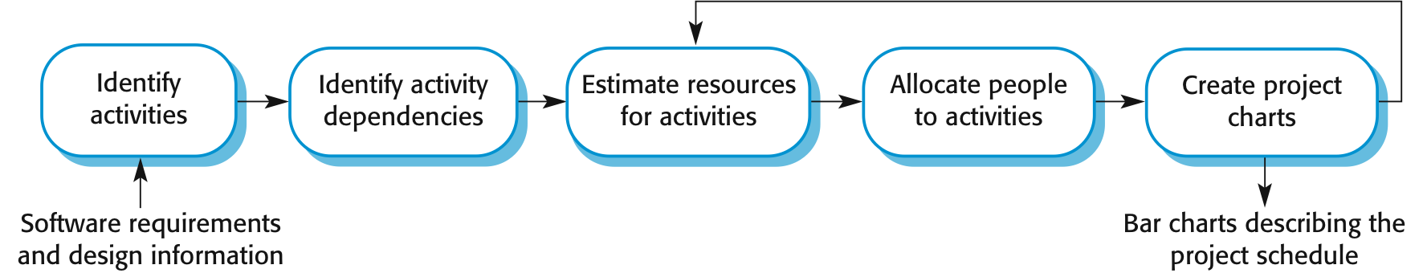
05.2. The project scheduling process

Slide 17
05.3. Scheduling problems
Estimating the difficulty of problems and hence the cost of developing a solution is hard
Productivity is not proportional to the number of people working on a task
Adding people to a late project makes it later because of communication overheads
The unexpected always happens. Always allow contingency in planning.

Slide 18
05.4. Schedule representation
Graphical notations are normally used to illustrate the project schedule
These show the project breakdown into tasks. Tasks should not be too small. They should take about a week or two.
Bar charts are the most commonly used representation for project schedules. They show the schedule as activities or resources against time.

Slide 19
06. Agile planning
Agile methods of software development are iterative approaches where the software is developed and delivered to customers in increments
Unlike plan-driven approaches, the functionality of these increments is not planned in advance but is decided during the development
The decision on what to include in an increment depends on progress and on the customer’s priorities
The customer’s priorities and requirements change so it makes sense to have a flexible plan that can accommodate these changes

Slide 20
06.1. Agile planning stages
There are two stages in agile planning:
Release planning, which looks ahead for several months and decides on the features that should be included in a release of a system
Iteration planning, which has a shorter term outlook, and focuses on planning the next increment of a system. This is typically 2-4 weeks of work for the team.

Slide 21
06.2. Agile planning Approaches
Approaches to agile planning:
Based on managing a project backlog (things to be done) with daily reviews of progress and problems.
The planning game developed originally as part of Extreme Programming (XP). Dependent on user stories as a measure of progress in the project.

Slide 22
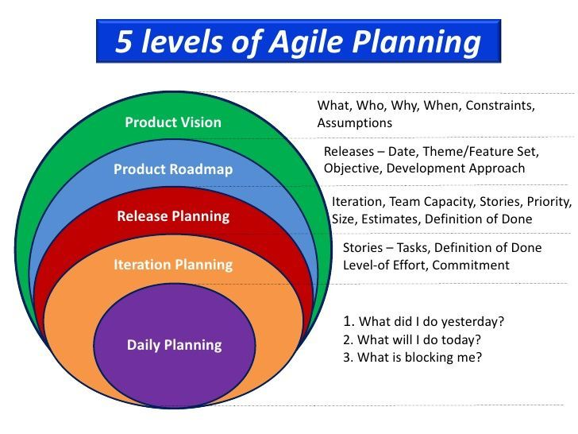
06.2. Agile planning diagram

Slide 23
07. Estimation techniques
Experience-based techniques:
The estimate of future effort requirements is based on the manager's experience of past projects and the application domain. Essentially, the manager makes an informed judgment of what the effort requirements are likely to be.
Two types of techniques can be used for making estimates:
Experience-based techniques
Algorithmic cost modeling

Slide 24
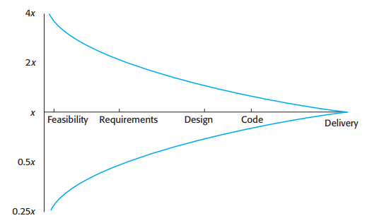
07. Estimation techniques
Algorithmic cost modeling:
In this approach, a formulaic approach is used to compute the project effort based on estimates of product attributes, such as size, and process characteristics, such as experience of staff involved.

Slide 25
08. Algorithmic cost modelling
Cost is estimated as a mathematical function of product, project and process attributes whose values are estimated by project managers:
Effort = A ∗ Size^{B} ∗ M
A is an organization-dependent constant, B reflects the disproportionate effort for large projects and M is a multiplier reflecting product, process, and people attributes.
The most commonly used product attribute for cost estimation is code size
Most models are similar but they use different values for A, B and M.

Slide 26
09. COCOMO cost modeling
COCOMO (Constructive Cost Modeling) cost modeling is an empirical model based on project experience. It is a well-documented, 'independent' model which is not tied to a specific software vendor.
The sub-models in COCOMO are:
Application composition model used when software is composed from existing parts.
Early design model used when requirements are available but design has not yet started.
Reuse model used to compute the effort of integrating reusable components.
Post-architecture model used once the system architecture has been designed and more information about the system is available.

Slide 27

Thanks for listening!
Any questions?

